Slide 1
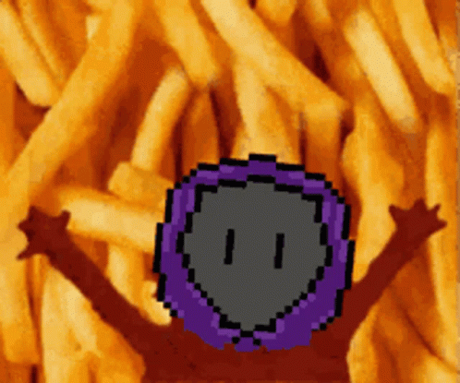
DATE
Kossy
Citizenship 9

Slide 2
TABLE OF CONTENTS
TABLE OF CONTENTS
WHERE
1
2
3
4
Personal
Community
Global
Aspirational

Slide 3

The Personal Place
Cit 9 WHERE
MAP SCREENSHOT (from Bing Maps) | Reflection: Write about a personal place that holds significance for you. Tell the story of the place! A personal space that holds a significance to me is nigeria becays ei grew up there kind of and my grandparents are there Guiding Questions: In a second section, describe how your personal perspective shapes the way you see and feel about this place. What stories or memories are tied to this specific location? It shapes me to see thing differently and makes me focus on my studies i stead of playing around it made me understand that the world isn’t a bed of roses that i have to work sometimes to get things i want | IMAGE
Notes:
The Personal Place
Reflection: Write a paragraph about a personal place that holds significance for you.
Guiding Questions:: In a second section, describe how your personal perspective shapes the way you see and feel about this place. What stories or memories are tied to this specific location?

Slide 4
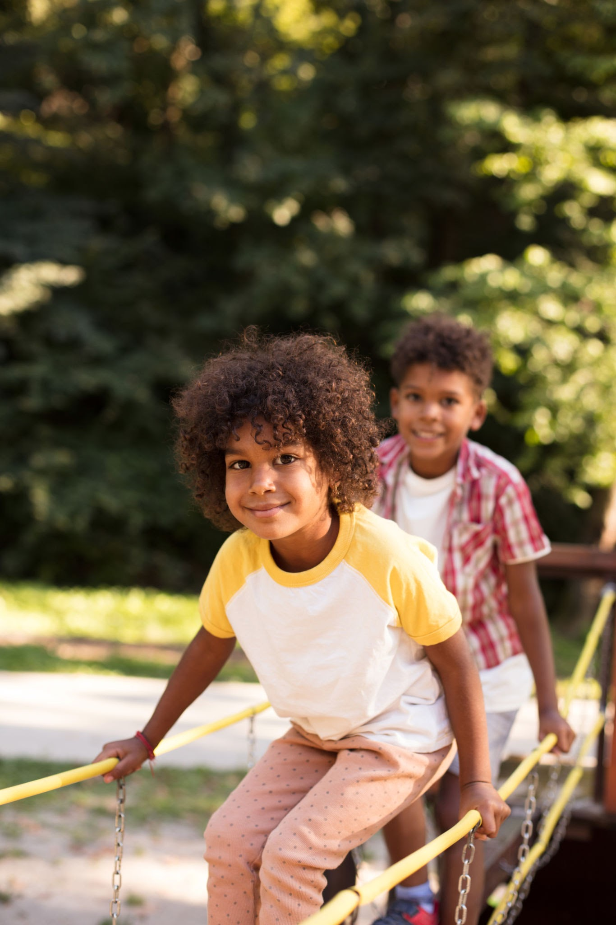
The Community Place
Cit 9 WHERE
MAP SCREENSHOT | Reflection: Write about a significant place in our local community. Tell the story of the place! Who owns it? Why do you like it? Describe something that happened there that you remember. My grandmas house because thats where me and my cousins always have sleepovers at and we have fun and then we go to play with my older cousins sometimes | IMAGE
Notes:
Reflection: Write about a significant place in our local community. Tell the story of the place! Who owns it? Why do you like it? Describe something that happened there that you remember.

Slide 5
The Global Place
Cit 9 WHERE
MAP SCREENSHOT | Reflection: Write a story about a place in the world that is part of your family's story. My grandparent house(from my dad’s side) it was fun but i wasn’t really close w my grandparents Guiding Questions: Tell the story of how you and/or your family are connected to this place. We all came to the house to celebrate any event and it was fun we would dance and even play around and my grandparents would pay us money for doing nothing What traditions or values from this place have been passed down to you? I don’t think any traditions were passed down How does this connect to your cultural identity, including things you do and who you are? I love being nigerian bu people don’t see my perspective the way i do and they always find a way to just say something about where im from but i just ignore sometimes i feel bad but its ok | IMAGE
Notes:
Reflection: Write a story about a place in the world that is part of your family's story.
Guiding Questions: Tell the story of how you and/or your family are connected to this place.
What traditions or values from this place have been passed down to you?
How does this connect to your cultural identity, including things you do and who you are?

Slide 6
The Aspirational Place
Cit 9 WHERE
MAP SCREENSHOT | Reflection: Write a story about a place you have never been to but dream of visiting. I went to the UK and i had my own house and it was big and i was aloud to do anything i want Guiding Questions: What draws you to this place? What do you hope to learn or experience there? How does this place fit into your hopes for the future? I hope to see my cousins and start a new life and learn more about the place | IMAGE
Notes:
Reflection: Write a story about a place in the world that is part of your family's story.
Guiding Questions: What draws you to this place? What do you hope to learn or experience there? How does this place fit into your hopes for the future?

Slide 7
The Aspirational Place
Cit 9 WHERE
Soundtrack of your life | Post the youtube link here | What’s the story on the song? Write here!
Notes:
Reflection: Write a story about a place in the world that is part of your family's story.
Guiding Questions: What draws you to this place? What do you hope to learn or experience there? How does this place fit into your hopes for the future?

Slide 8
THANK YOU

